Slide 1
Additive Measures

Slide 2
Types of Additive Measures
Fully Additive Measures
Semi Additive Measures
Non Additive Measures

Slide 3
Fully Additive Measures
Fully Additive measures are values that you can summarize across any related dimension including the time dimension.
Fully additive measures can be sliced and diced in any "direction," for example.
Example →
Sales and costs are fully additive; if you sell 100 yesterday and 50 today then you’ve sold 150 in total. You can add them up over time.

Slide 4
Semi Additive Measures
Semi Additive measures are values that you can summarize across any related dimension except the time dimension.
A semi additive measure can be aggregated along some, but not all, dimensions that are included in the measure group that contains the measure.
Aggregating semi additive measure along a time dimension would produce incorrect results.

Slide 5
Examples of Semi Additive Measures
Stock levels are semi additive; if you had 100 in stock yesterday, and 50 in stock today, you’re total stock is 50, not 150. It doesn’t make sense to add up the measures over time, you need to find the most recent value.
Periodic measurements, such as account balances (for example, the daily balance of a bank account), level measurements (such as on-hand inventory quantities or personnel headcounts), and the like, do not share the qualities of fully additive measures.
An Inventory level might be additive along the Product, Store and Warehouse dimensions of a cube, but would be non-additive across the Time dimension of the cube.

Slide 6
Non Additive Measure
A Non Additive measure cannot be aggregated along any dimension in the measure group that contains the measure..
Example →
A calculated measure that returns a percentage, such as profit margin, cannot be aggregated from the percentage values of child members in any dimension.

Slide 7
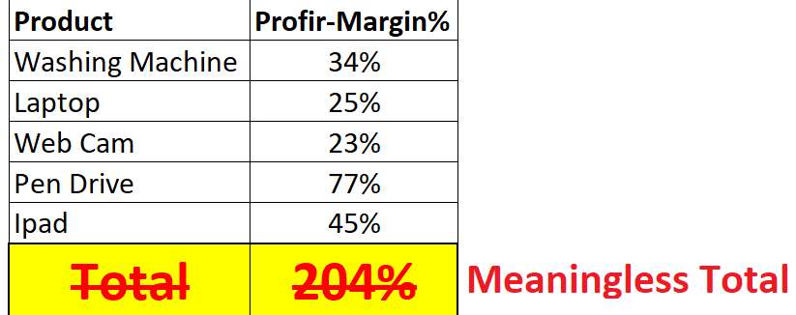
Explanation of Non Additive Measure
If you add the profit-margin % of all the products for a retail company, you may get a figure of much more than 100%!
When you are applying aggregation on a ratio, one need to take the 'ratio of the sums', instead of 'sum of the ratios’.

